Slide 1
Justifying terms of a sequence
Task A: Justifying terms of a sequence
1) Will 467 be in the arithmetic sequence starting -6, 2, 10, 18, …? Justify your answer.
2) 113 and 129 are consecutive terms in an arithmetic sequence. Will 12 718 be in the sequence? Justify your answer.
3) Will 467 be in the arithmetic sequence starting -6, -1, 4, …? Justify your answer.
4) 113 and 123 are consecutive terms in an arithmetic sequence. Will 12 713 be in the sequence? Justify your answer.

Slide 2
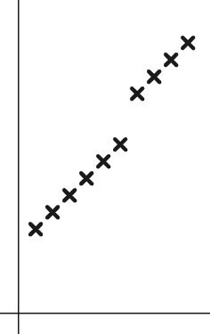

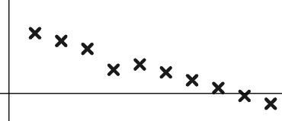
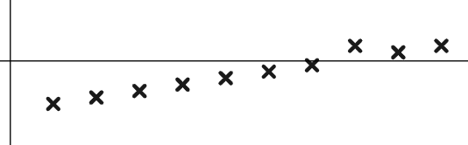
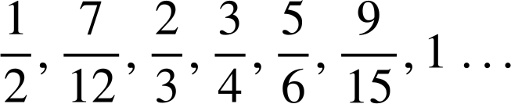
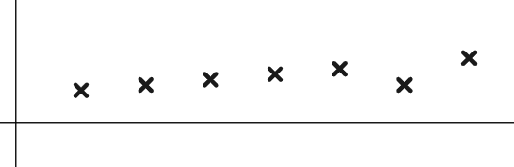
Justifying terms of a sequence
Task B: Using a graphical representation
1) Sam is asked to continue this arithmetic sequence and plot it.
127 850, 135 350, 142 850, …
Term value
They write the below values and plot them.
127 850, 135 350, 142 850, 150 350, 157 850, 165 350, 178 250, 185 750, 193 250, 200 750, …
Term number
Write a sentence explaining how you know there has been an error.
2) Use the graphs to spot the incorrect terms in these arithmetic sequences.
a) 0.83, 0.72, 0.61, 0.3, 0.39, 0.28, 0.17, 0.06,−0.05,−0.16, …
Term value
Term number
b) −0.1,−0.85,−0.7,−0.55,−0.4,−0.25,−0.1, 0.35, 0.2, 0.35, …
Term value
Term number
c)
Term value
Term number

Slide 3
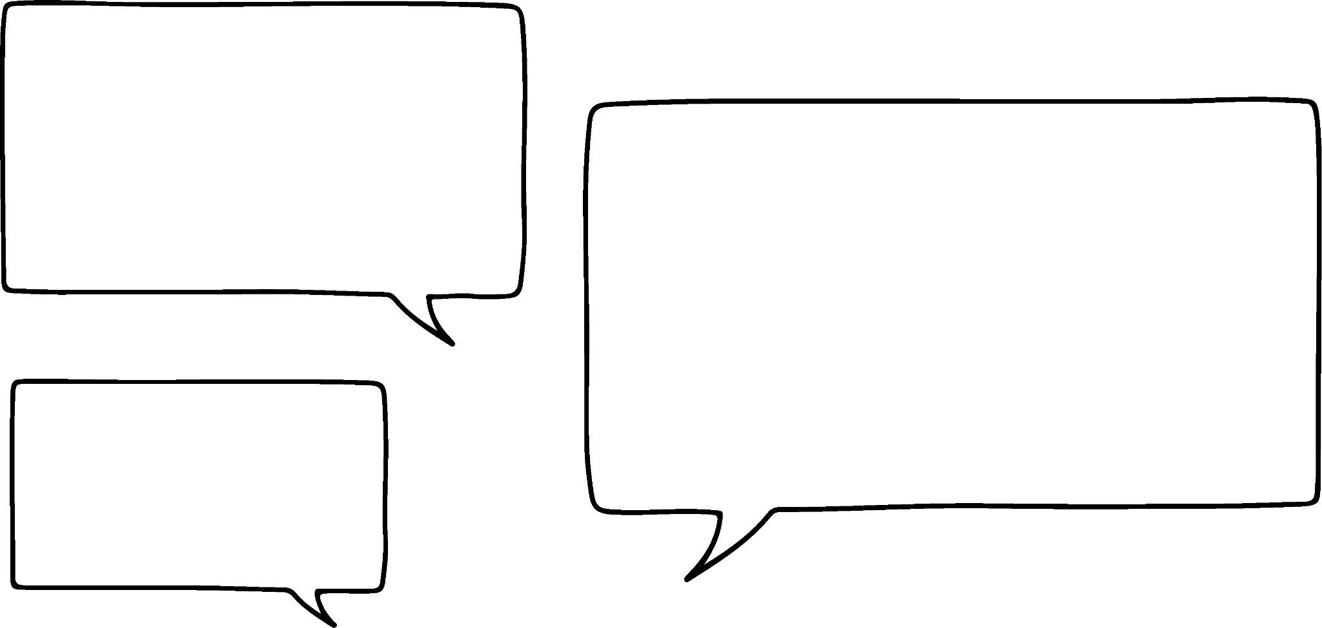

Justifying terms of a sequence
3) Laura is asked if the sequence 117 is in the sequence starting −8, −2, 4, 10, 16, …
She says:
“I’ll draw a graph and see if 117 is in line”
Write a sentence explaining why this might not be the most efficient method to use on this occasion.
Task C: Using the n^{th} term
1) Use n^{th} term and approximation to find 400 in the arithmetic sequence starting 10, 23, 36, 49, …
2) Is 400 in the arithmetic sequence starting −22, −14, −6, 2, …
Write a sentence to justify your answer.
3) Is −12.75 in the arithmetic sequence starting 21.25, 20.9, 20.55, 20.2, … Fully justify your answer.
Mathematics in Education and Industry
v2.1

